Slide 1

Deep Learning-based Web Portal for Facial Applications
Big Data Squad
CMPT 733
Final Project Presentation
Spring 2020
Notes:
We developed a full stack deep learning web portal for several facial applications

Slide 2

Outline
Motivation: Facial Applications
Full Stack Deep Learning Workflow for Facial Application
Methodology: CNNs, Transfer Learning, One-shot Learning, GANs
Results and Demo
Notes:
Today we present our motivation, approach, methodology employed, followed by results and demonstration of our product.

Slide 3
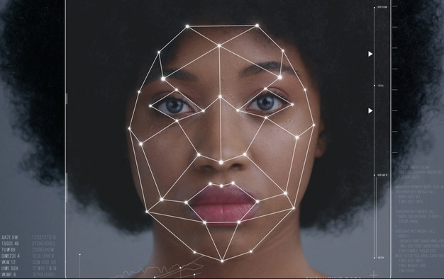

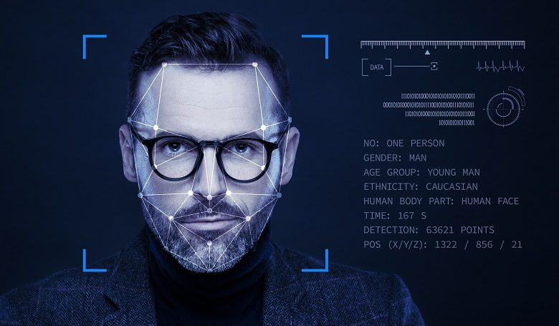
Face Applications
Face Detection and Recognition
User identification and authentication in electronic transactions
Secure access control system for buildings, ATMs and phones
Criminal identification to protect law enforcement
Find missing persons, Helping blind people
Facial Synthesis
Create anime characters in game and animation production
Face anonymization for privacy protection
Artificial intelligent portrait painting
Gender Prediction, Age Estimation, Emotion Recognition
Smart advertising for marketing intelligence
Automated monitoring systems for seniors
Automated healthcare systems to track patient conditions
Automated driving safety systems
Access control systems
Visual surveillance
Notes:
Our focus is on 6 facial applications: 1. Face Detection, face Recognition, face synthesis, gender and age prediction as well as facial emotion recognition.
These tasks are extremely important for user identification and authentication, in secure access control systems for ATMs and phones, criminal identification, helping blind people, as well for face anonymization in privacy protection, in smart advertising, in automated monitoring systems for seniors, and patients, and the list can go on.

Slide 4
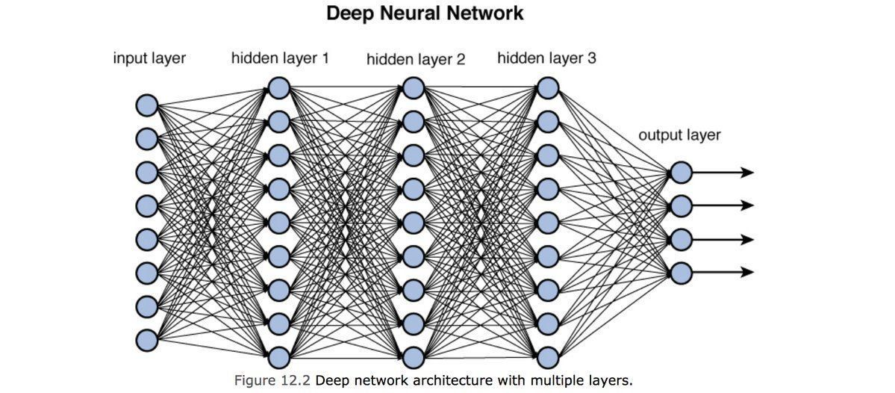
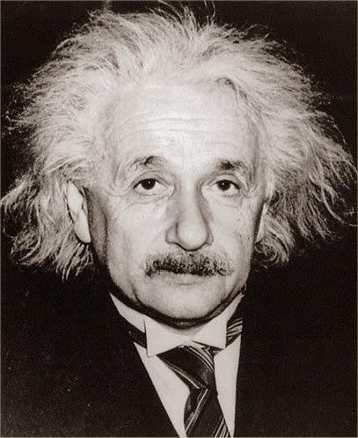
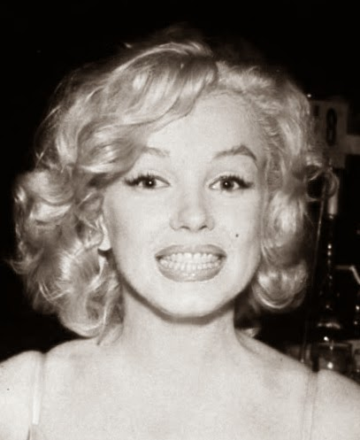
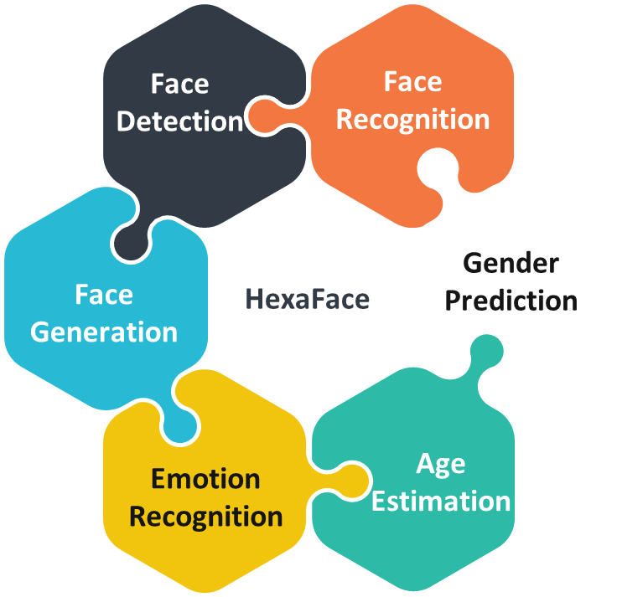
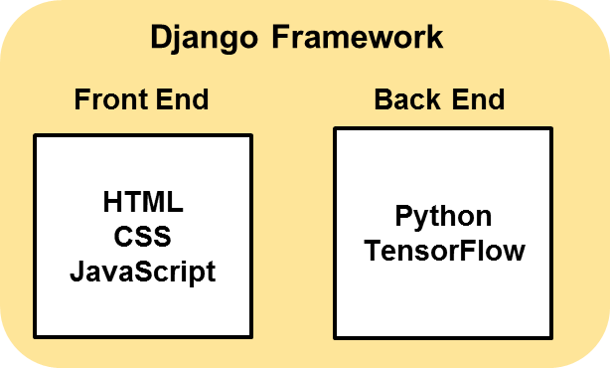
Full Stack Deep Learning Workflow for Face Applications
Albert Einstein
Gender: Male
Age: 70
Emotion: Neutral
Train
Deploy
Notes:
For full-stack deployment, we first trained the models on appropriate dataset with deep learning methods, and evaluate them separately for each task, then we developed a web application in Django framework to deploy the models.

Slide 5
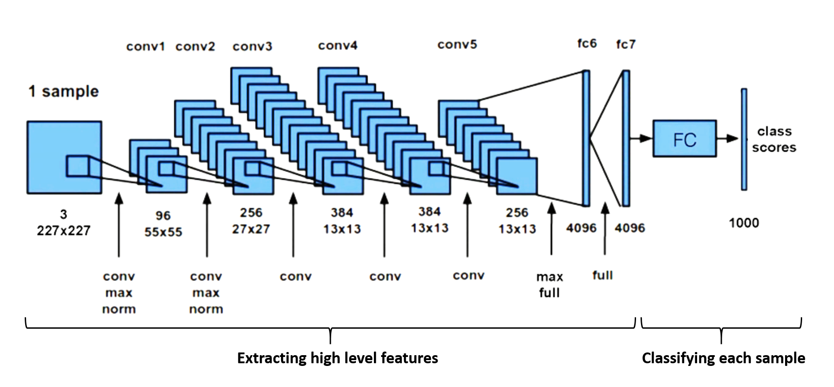
Convolutional Neural Networks for Feature Extraction
We developed ConvNets from scratch, as well used transfer learning with VGG16 for classification tasks
For facial synthesis and face recognition we employed generative adversarial networks and one-shot learning
Notes:
Convolutional neural nets were the primary method used for feature extraction from images, the figure show a typical CNN architecture with five convolutional layers, 2 fully connected layer and the last layer for classification. We developed convnets from scratch, as well we used transfer learning with VGG16 for classification tasks. For facial synthesis and face recognition we employed generative adversarial networks and one-shot learning, respectively.

Slide 6
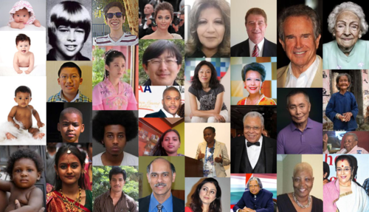
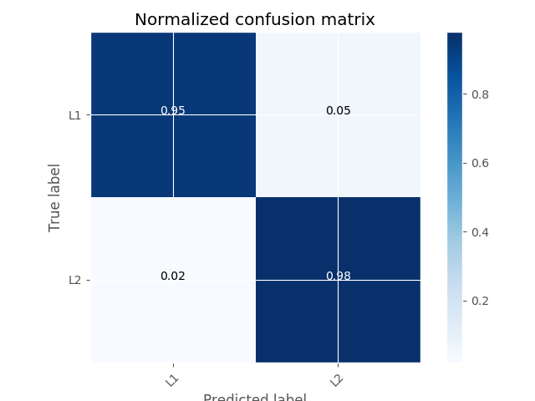
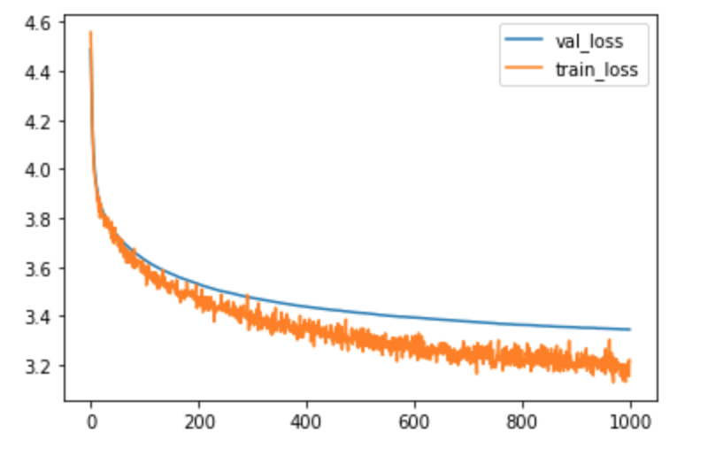
Gender and Age Prediction
Dataset: imdb-wiki dataset
Method: Transfer Learning with VGG16
Challenge: Preprocessing, expressions, lighting, pose
Results (gender): Achieved accuracy > 95%
Results (age): +/- 6 years (mean absolute error)
Notes:
For gender and age prediction, we used imdb-wiki dataset, and transfer learning with VGG16 to extract the features, then we trained a classifier on top of that for gender and age predictions. An accuracy above 95% obtained for gender prediction and +/6 year for age estimation.

Slide 7
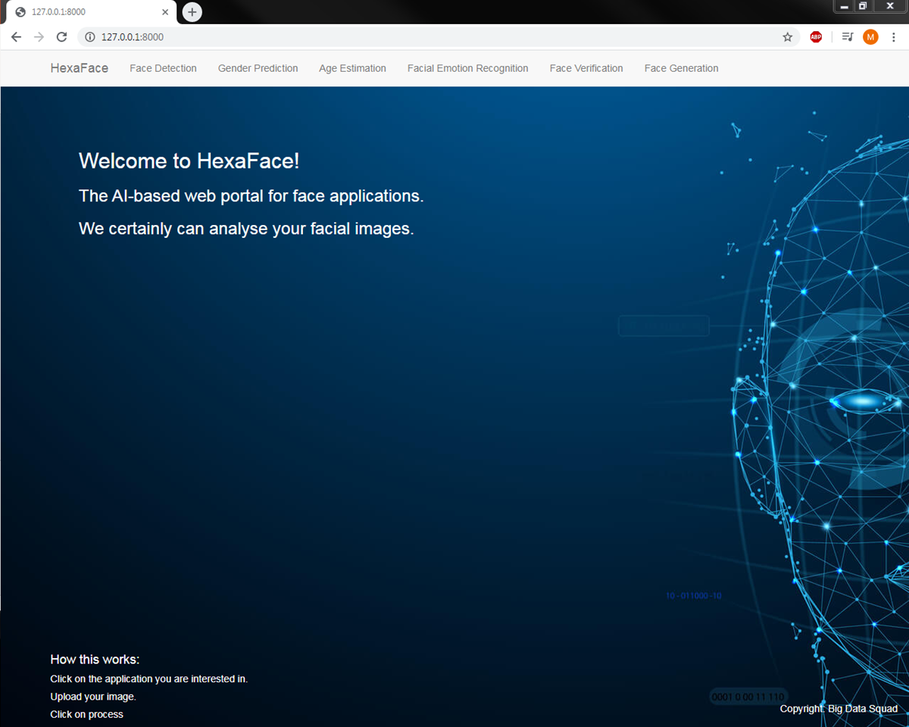
HexaFace: AI-based Web Portal for Face Applications
Notes:
This slide shows the first page of our web application, we named it HexaFace as it performs 6 facial applications.

Slide 8
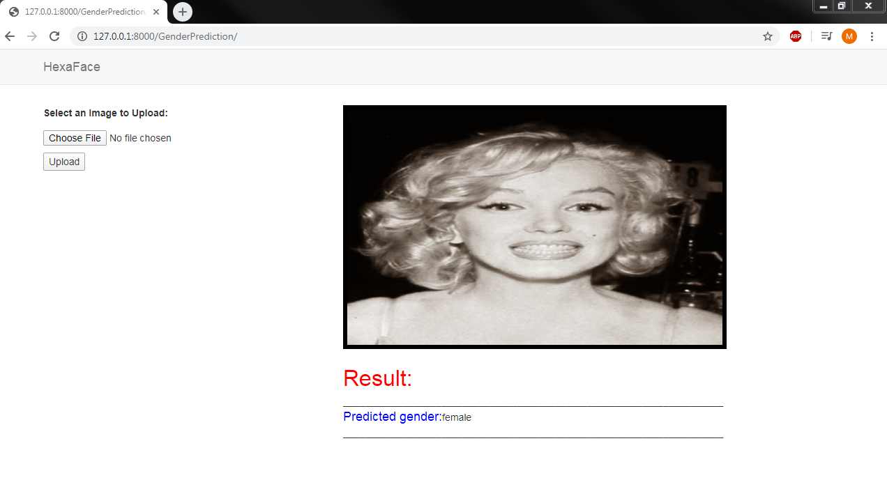

Notes:
In this page we can choose and upload the image and click on process to predict the gender. As can be seen it is correctly predicted as female here.

Slide 9
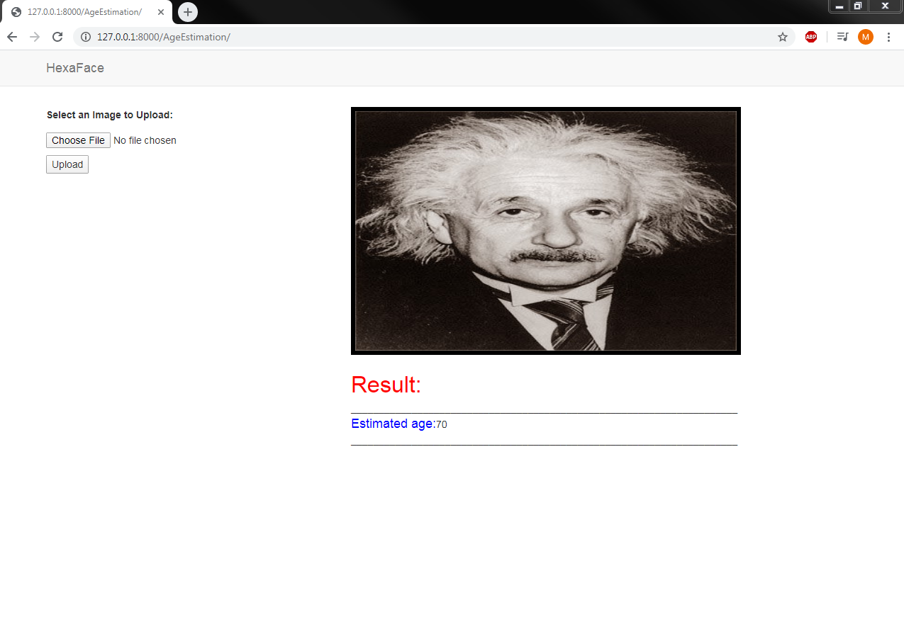

Notes:
This one is for age estimation and the model predicted as 70 years old, which is reasonable for this image.

Slide 10
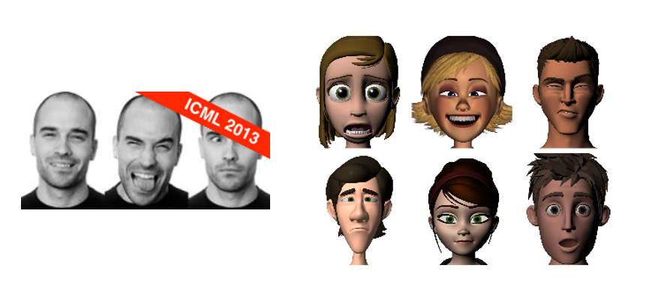
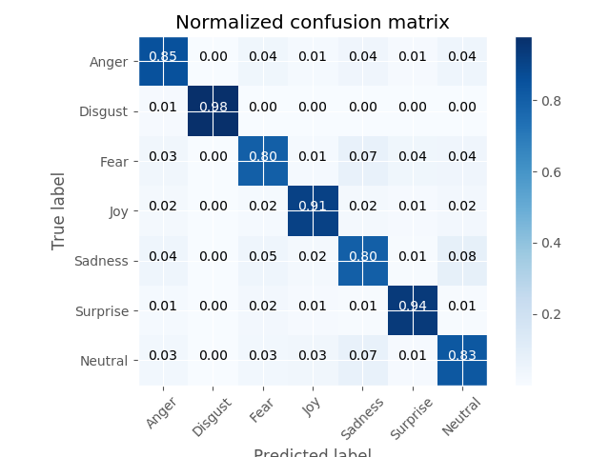
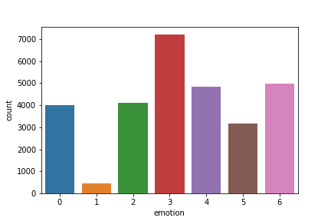
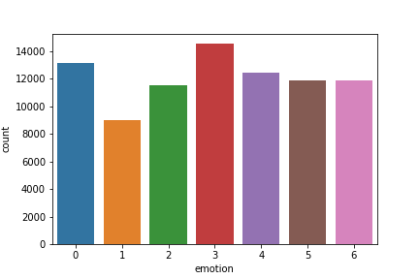
Facial Emotion Recognition
Dataset: Combined FER-2013 and FERG-DB
Method: VGG-like CNN developed from scratch
Challenge: Imbalanced and noisy dataset
Results: Accuracy of ~ 60% on FER-2013
Accuracy of ~90% on combined dataset
FER distribution
FER+FERG-DB distribution
Notes:
For facial emotion recognition we trained a VGG-like CNN architecture from scratch on FER-2013 dataset and we did not obtain accuracy better than around 60%, We combined this dataset with FERG-DB and trained the model again, this time we obtained accuracy of around 90%.

Slide 11
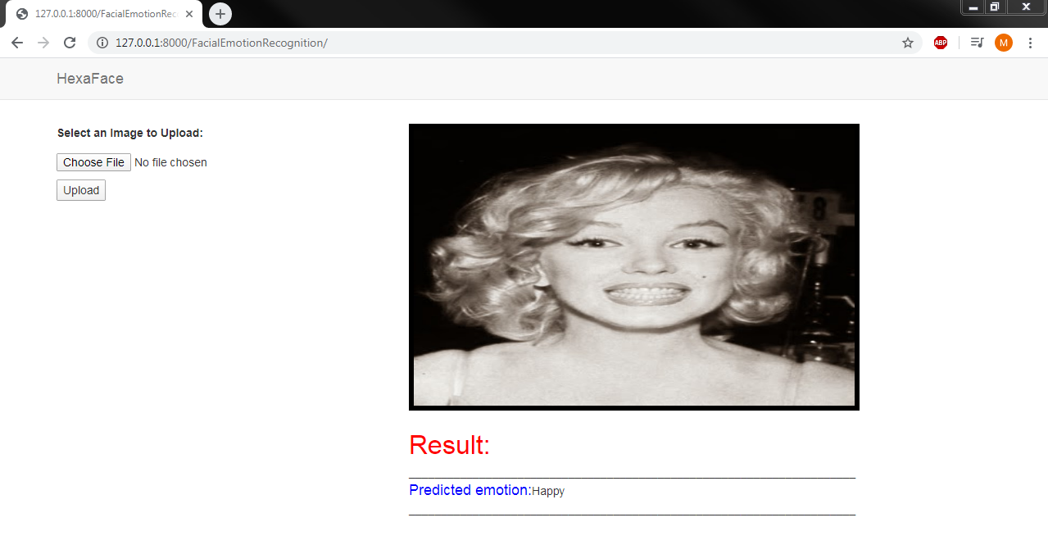

Notes:
Again we deployed the model in HexaFace, and as you can see here it correctly predicts the emotion as happy.

Slide 12
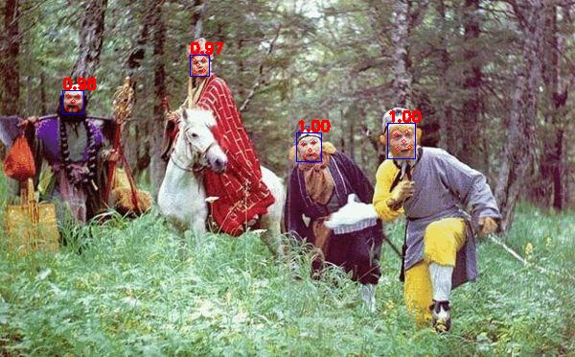
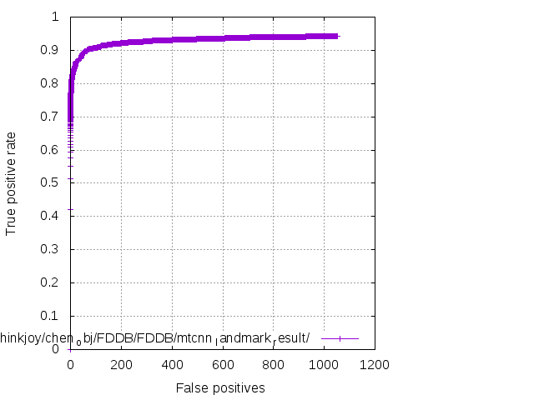
Face Detection
Face
Recognition
Dataset: WIDER FACE/CNN_FacePoint
Method: Multi-Task Cascade CNN (MTCNN)
Challenge: Computational Resources for Training
Results: 95% accuracy
Notes:
For face detection we trained MTCNN architecture on WIDER FACE dataset. This method first classify the face in image then put a bounding box and confidence score around it. The accuracy of 95% obtained for this model.

Slide 13
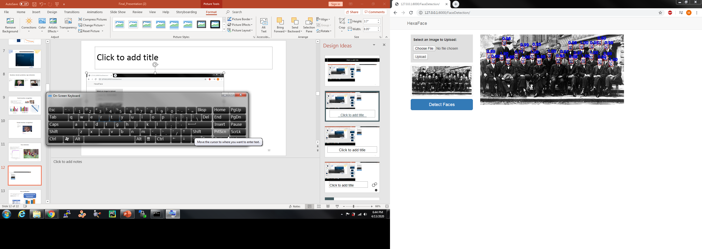

Notes:
As shown here the model is deployed and can accurately detect multi-faces in the image.

Slide 14
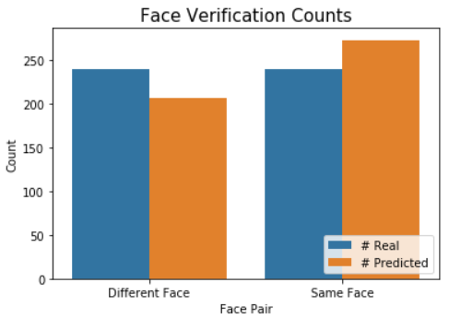
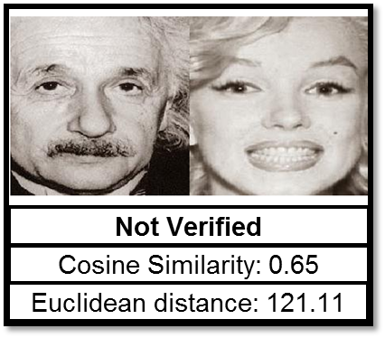
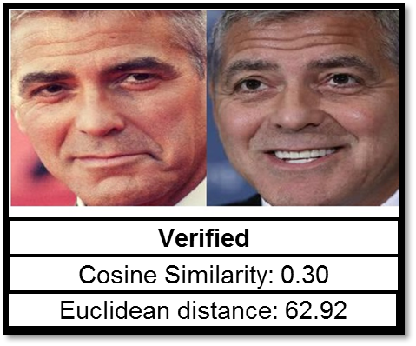
Face Verification
Dataset: Pre-trained model on VGG-Face dataset.
AT&T database for testing.
Method: Siamese CNN
Challenge: Position, Pose, Lighting
Results: 93% accuracy
Correctly verifies all matching pair of faces.
Some different faces are verified as a match
Good for criminal identification
Maybe good for user authentication with stricter threshold
Metric | Value
Accuracy | 0.93
Precision | 0.87
Recall | 1.0
F1-Score | 0.93
Notes:
In the test set:
Half of the pairs are chosen to be for the same person [but different poses].
The other half pairs are chosen to be for the different persons.
The system verified all the faces of the same person to be a match.
However, some of non-matching faces are also verified as match.

Slide 15
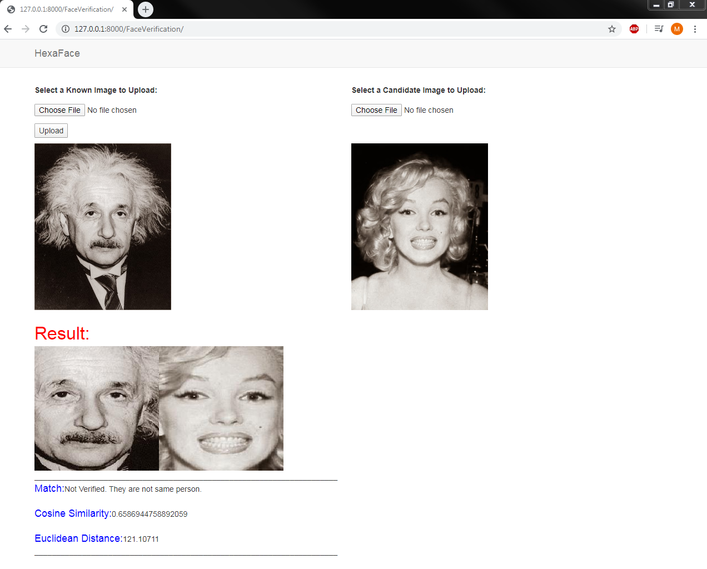

Notes:
This slide shows the deployment of face verification model in HexaFace.

Slide 16
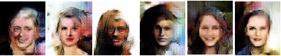
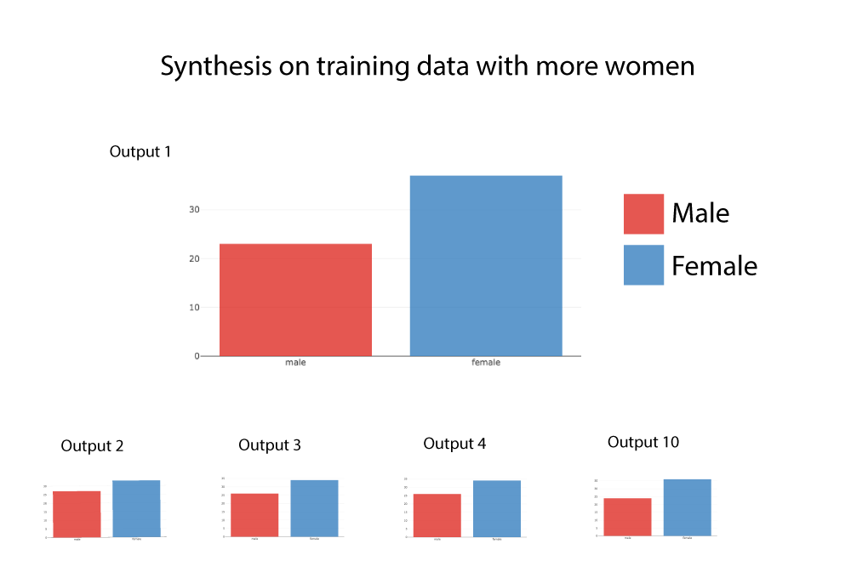
Facial Synthesis
Dataset: CelebA-Dataset
Method: DCGAN, Zero Sum training
Challenge: Training, comp. resources
Results: Multiple generations of 60 random faces
How does noisy training data/imbalanced data affect?
More than half are female all the time.

Slide 17
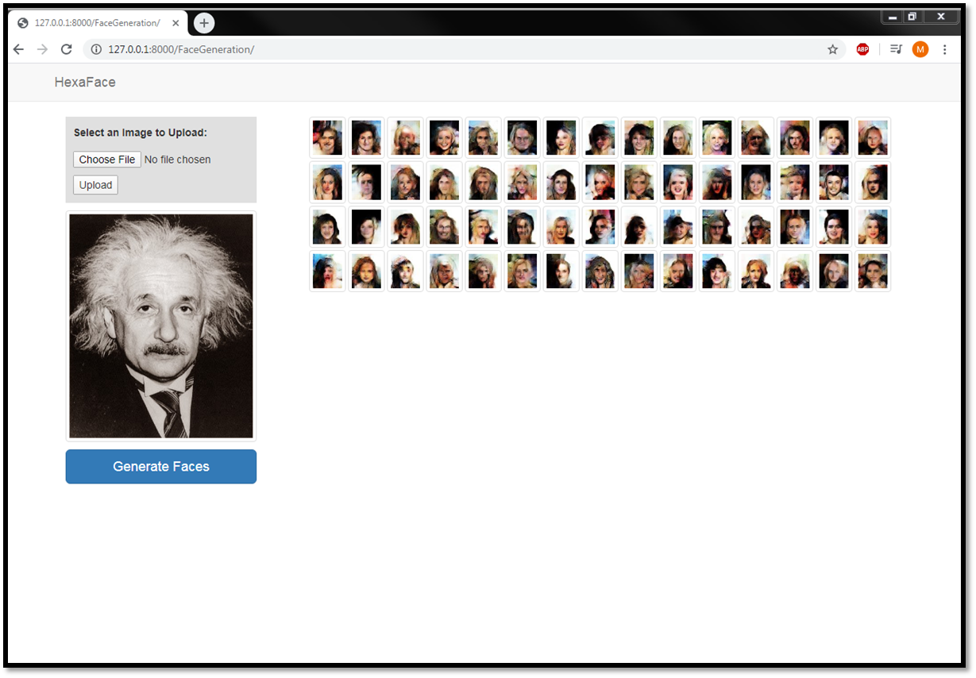


Slide 18


What We Learned…
Team work
Training ConvNets: preprocessing, choosing architecture, tuning, model evaluation
Transfer learning
Creating and launching web applications, integrating model files with python
Running instances on GCP
Main Challenges:
Computational resources and time is a huge bottleneck with model training
Finding high quality dataset in terms of resolution, variations of age, ethnicity.

Slide 19
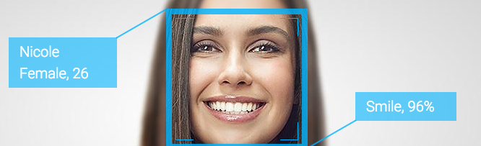
Path Ahead...
Improve model performances
Integrate all models for multi-task output
Host the application on the internet
Incorporate usage of GPUs and increase web app processing speed
Generate faces from detailed user-provided descriptions

Slide 20
Summary (backup)
Face Detection
Motivation: Predict face and landmark
Objective: Put a bounding box and confidence on face
Dataset: WIDER FACE/CNN FacePoint
Method: MTCNN
Challenge: Training, computational resources
Results: 95%+ accuracy
Face Recognition
Motivation: System authentication
Objective: Verify registered user face
Dataset: AT&T database of faces
Method: Siamese Neural Network
Challenge: Position, Pose, Lighting, etc
Results: Verified faces
Face
Detection
Face
Recognition
Face Generation
Motivation: Description to image
Objective: Generate synthetic faces
Dataset: CelebA-Dataset
Method: DCGAN, Zero Sum training
Challenge: Training, comp. resources
Results: Captured facial details
Gender
Prediction
Face Generation
HexaFace
Gender Prediction
Motivation: Intelligent applications
Objective: Predict gender from face
Dataset: imdb-wiki dataset
Method: Transfer Learning, VGG16
Challenge: Preprocessing
Results: Achieved accuracy of 90%
Emotion
Recognition
Age
Estimation
Emotion Recognition
Motivation: Human computer interaction
Objective: Recognize basic facial expressions
Dataset: Combined FER-2013 and FERG-DB
Method: VGG-like CNNs
Challenge: Imbalanced and noisy dataset
Results: Achieved accuracy of about 90%
Age Estimation
Motivation: Real-time applications
Objective: Predict apparent age
Dataset: Wiki & IMDB dataset
Method: Transfer learning, VGG16
Challenge: Expressions, lighting, pose, etc.
Results: +/- 6 years accuracy

Slide 21
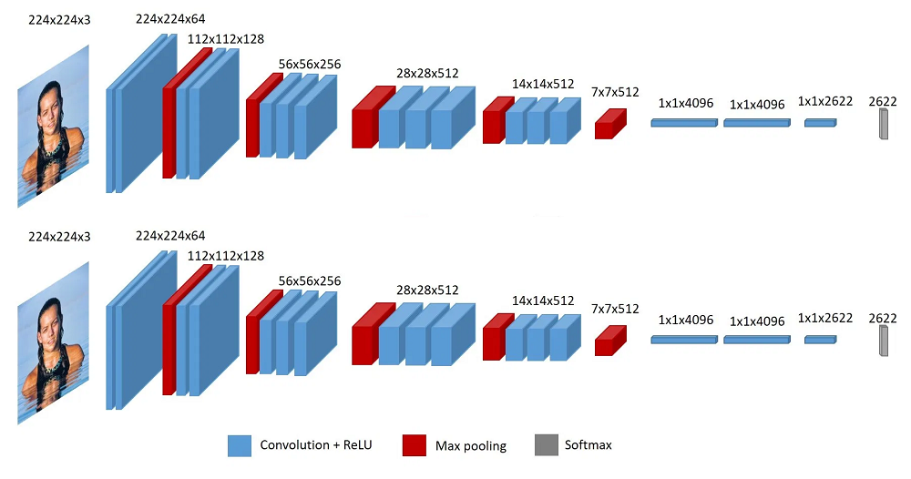
CNN for verification (backup)
Match
yes
Cosine
Distance
Function
< t
no
Non-Match
Notes:
We scratch the last layer of the model and remove the Softmax function to have a vector of 2622 facial features.
These vectors will be sent to a distance function (Cosine or Euclidean) to compute the distance.
If the distance is less than a threshold (t), two faces will be verified as a match.
Otherwise, they will be a non-match.

Slide 22
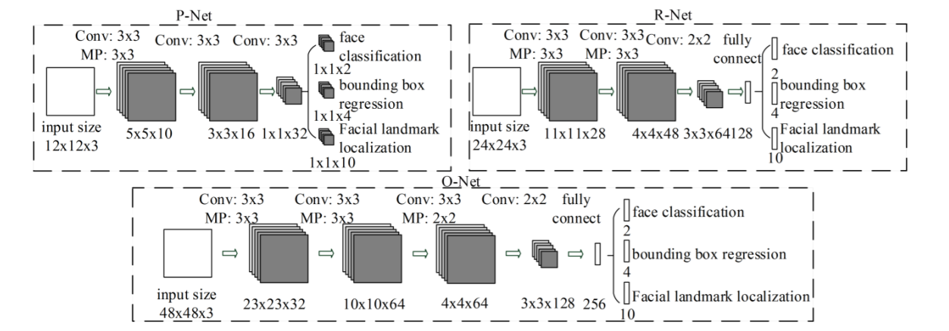
MTCNN for detection (backup)
Kaipeng Zhang, Zhanpeng Zhang, Zhifeng Li, Yu Qiao , " Joint Face Detection and Alignment using Multi-task Cascaded Convolutional Networks," IEEE Signal Processing Letter
Notes:
In this paper, we propose a new framework to integrate these two tasks(face detection and face alignment) using unified cascaded CNNs by multi-task learning. The proposed CNNs consist of three stages. In the first stage, it produces candidate windows quickly through a shallow CNN. Then, it refines the windows to reject a large number of non-faces windows through a more complex CNN. Finally, it uses a more powerful CNN to refine the result and output facial landmarks positions. “

Slide 23
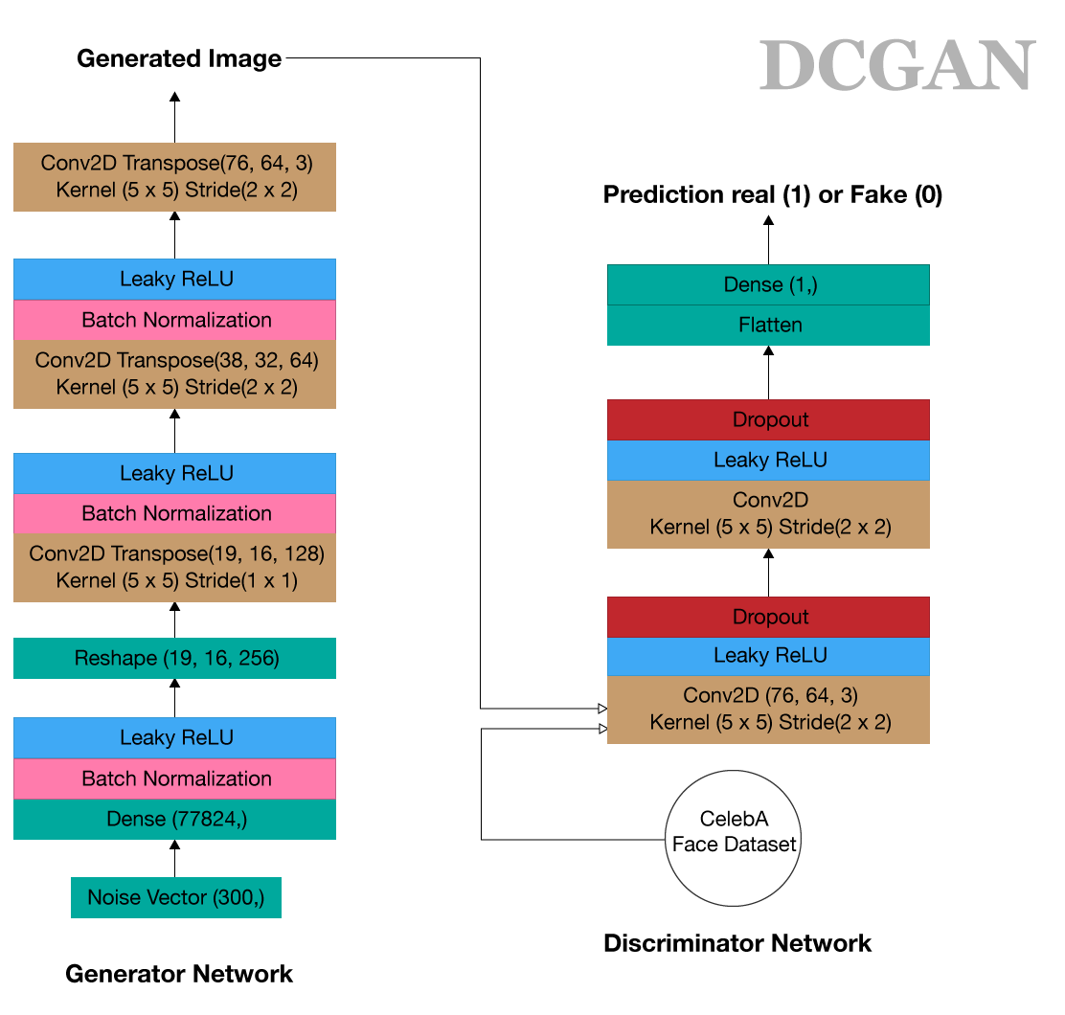
Deep Convolutional
GAN Architecture
for face generation (backup)

